Slide 1

AA 5750 – Contemporary Issues in Analytics
Understanding Neural Networks Intuitively

Slide 2

What is AI?
Definition: AI mimics human intelligence for tasks like learning and decision-making.
How: Algorithms emulate human logic using data.
Impact: Drives recommendations, diagnostics, autonomous systems.

Slide 3

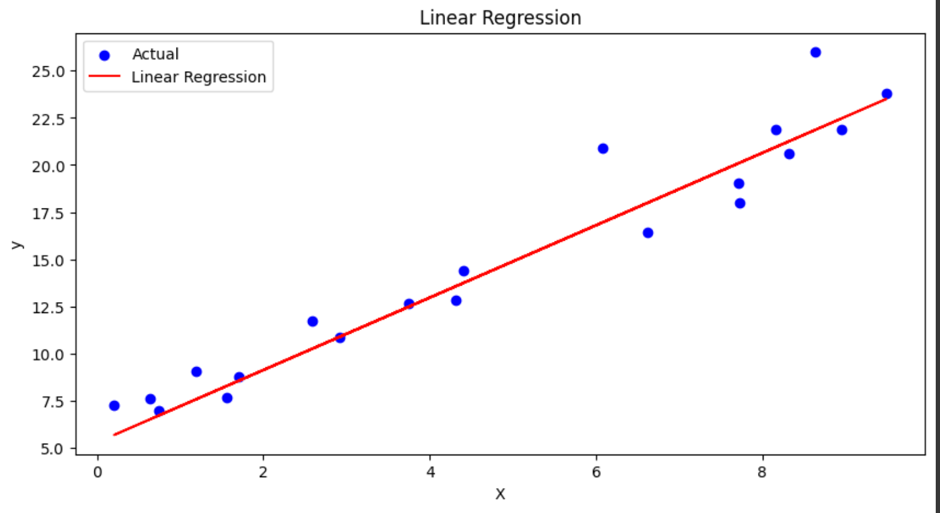
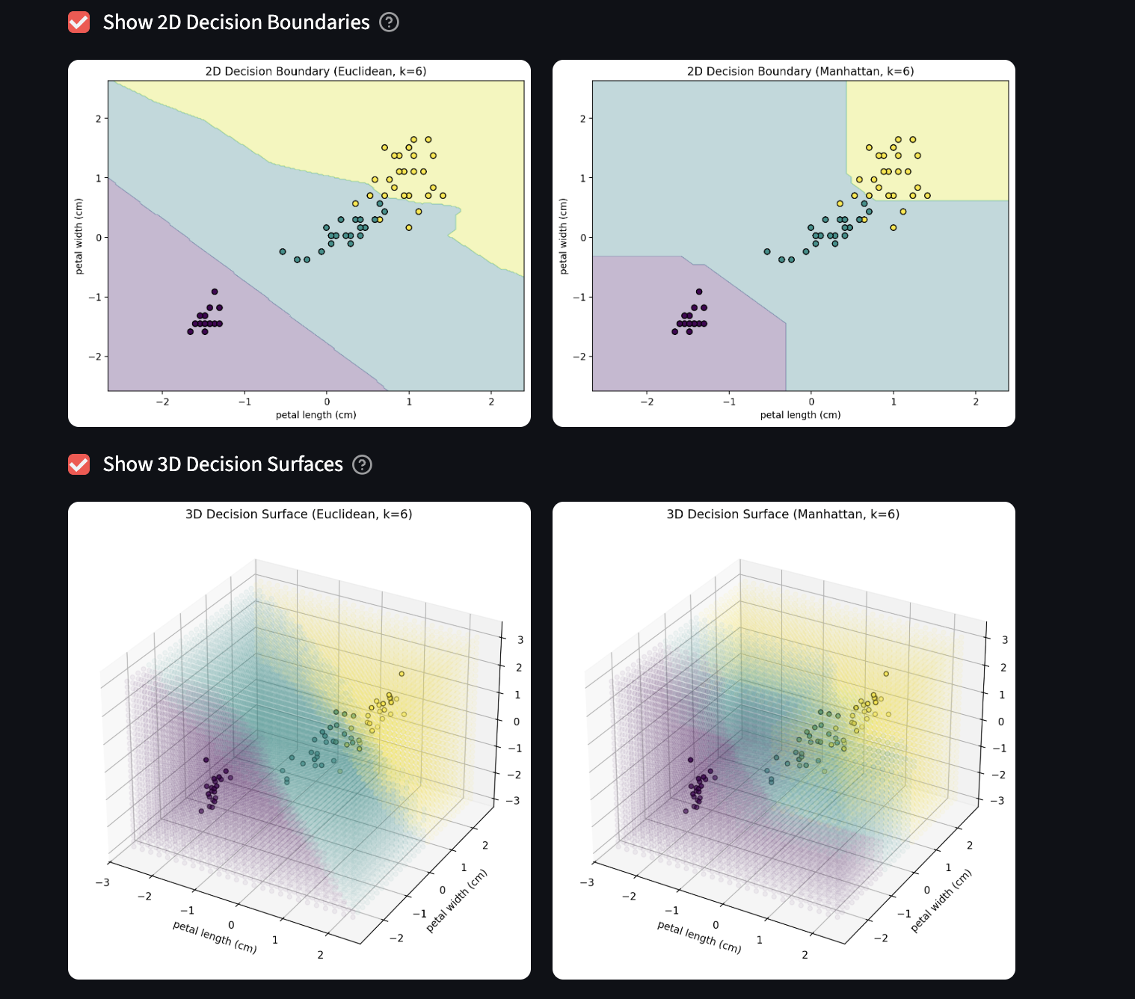
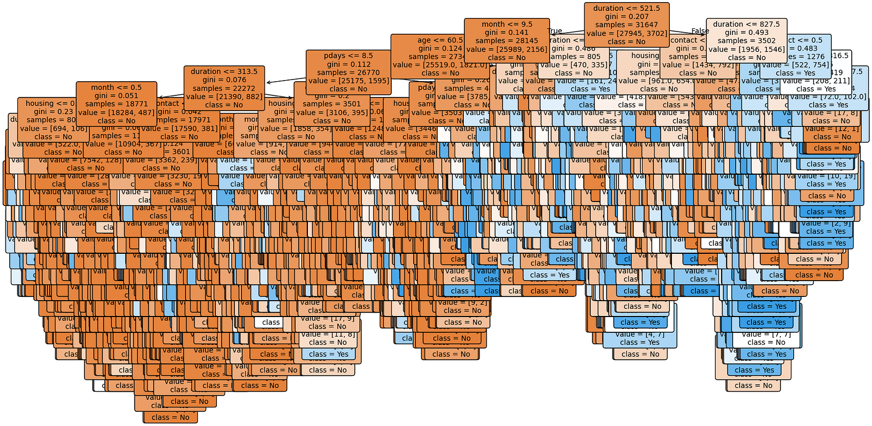
Classical Machine Learning
Purpose: Predict or classify using data patterns.
Algorithms:
  K-NN: Classifies by nearest neighbors (e.g., recommendations).
  Decision Trees: If-else rules (e.g., fraud detection).
  Logistic Regression: Linear boundaries (e.g., spam detection).
  SVM: Maximizes class margins (e.g., image classification).
  Naive Bayes: Probability-based (e.g., spam filters).
Core: Fits functions to predict new data.

Slide 4
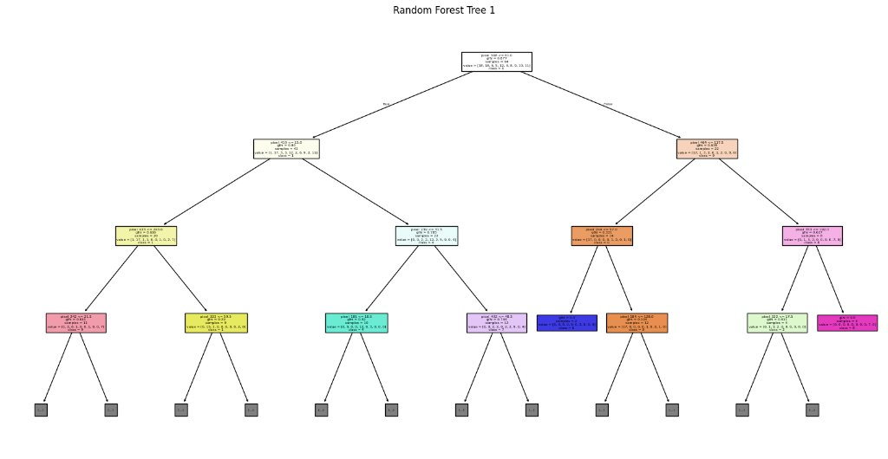
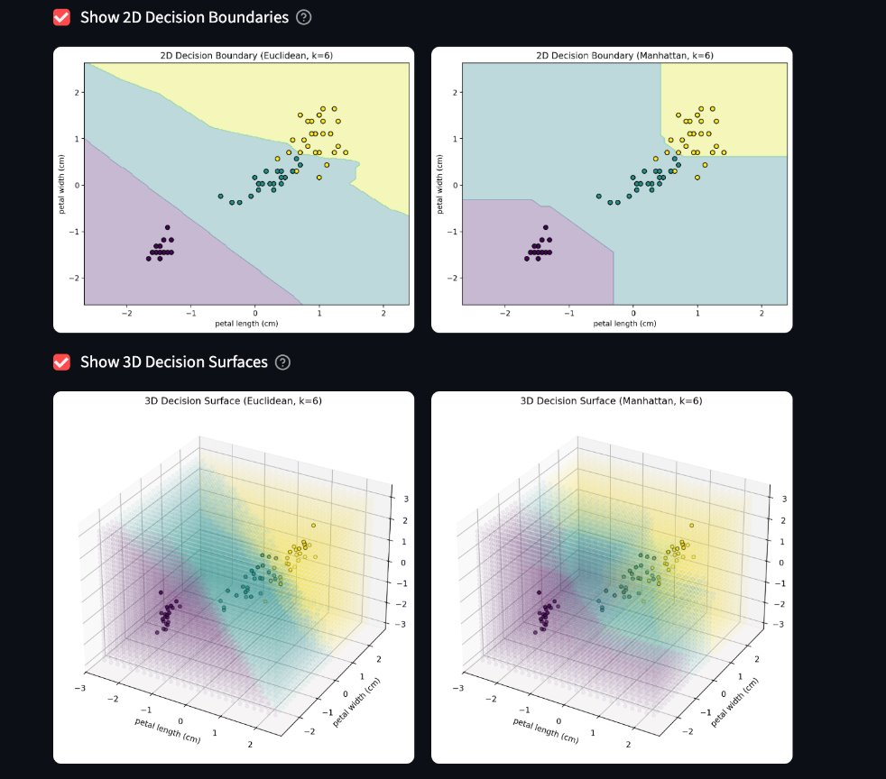
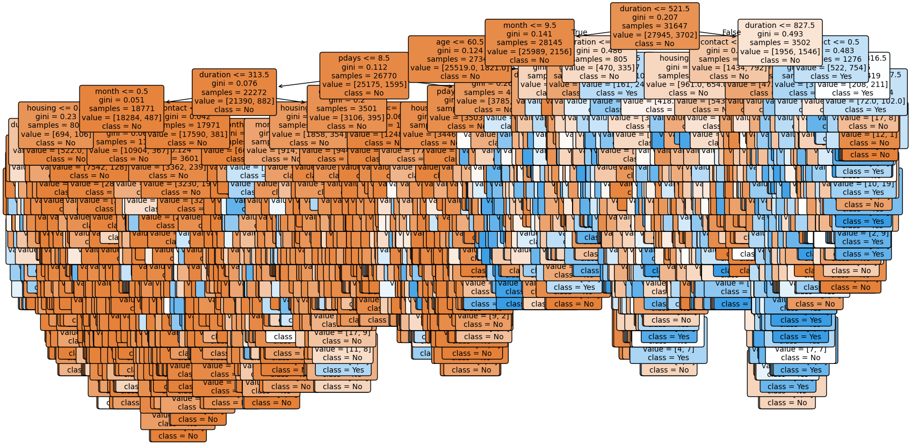
Classical ML

Slide 5
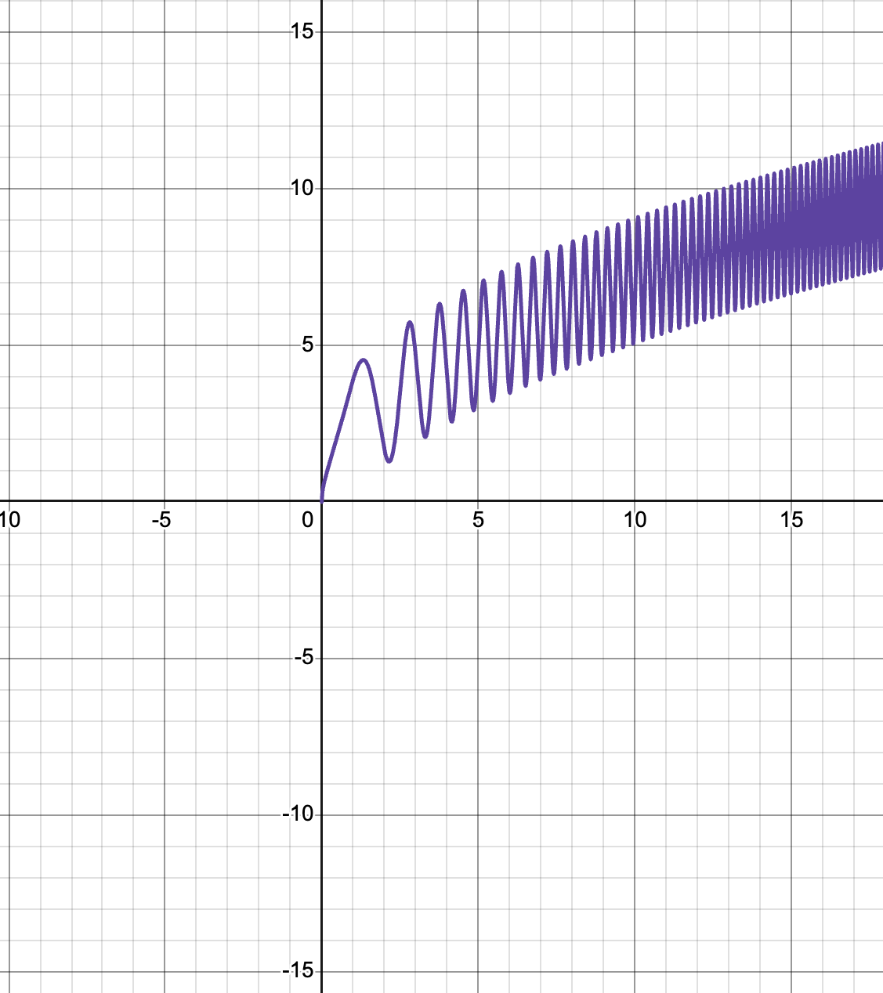
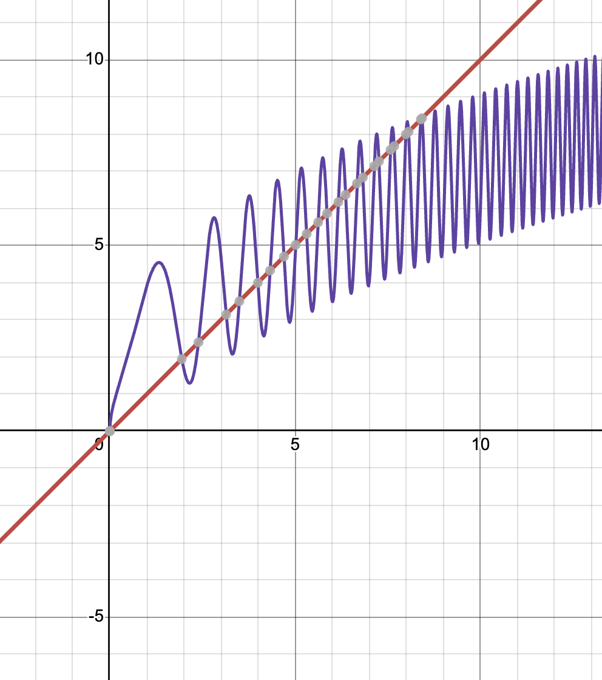
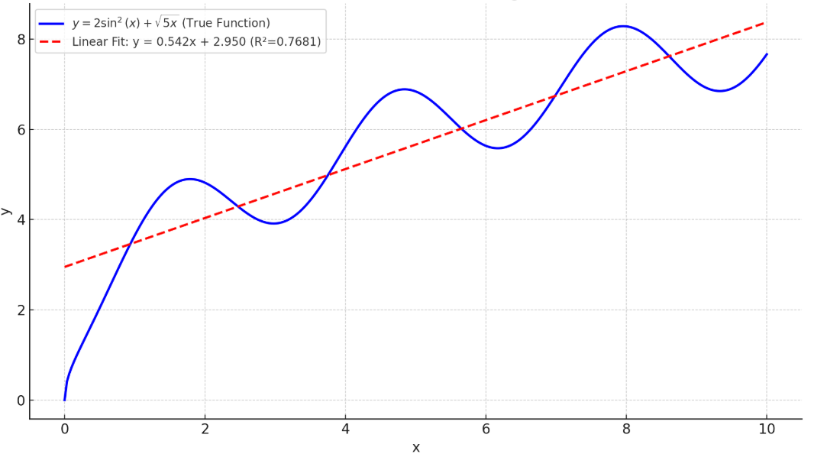
Importance of Non-Linearity
Why Needed? Linear models can’t capture complex patterns (e.g., XOR, circles, images).
Non-Linear Activations:
Enable complex decision boundaries.
Allow layers to build hierarchical features.
Impact: Makes deep networks universal approximators for any function.

Slide 6
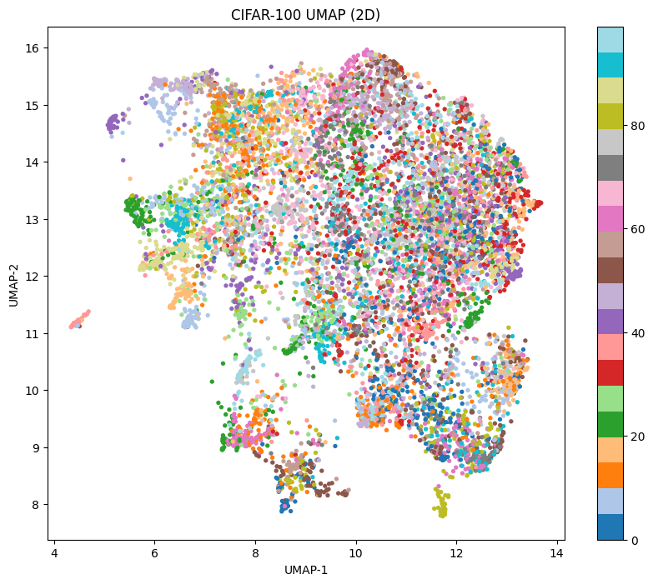
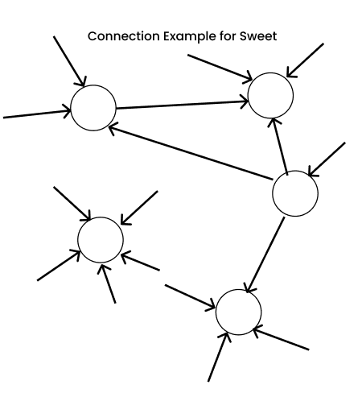
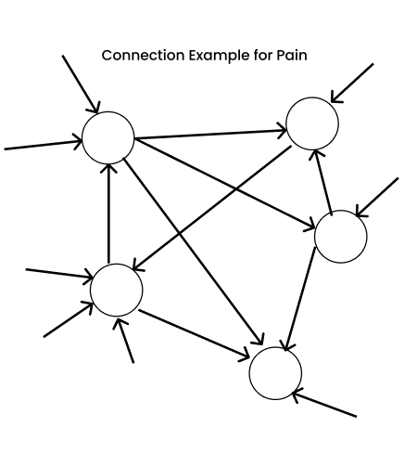
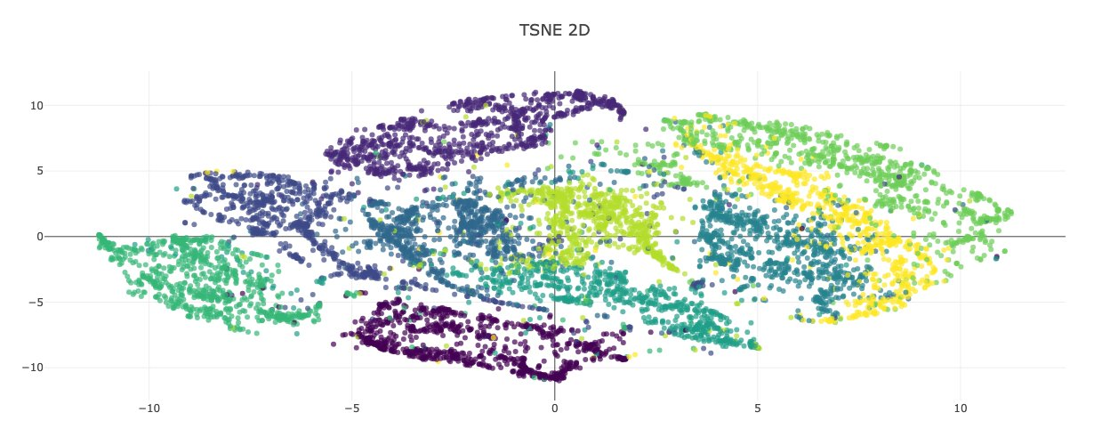
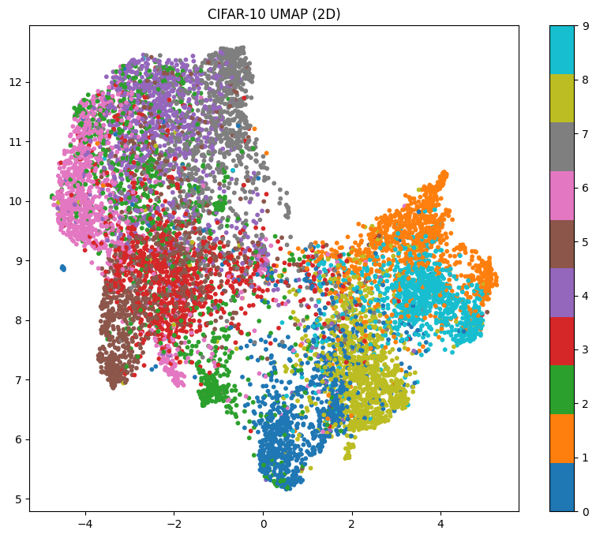

Slide 7
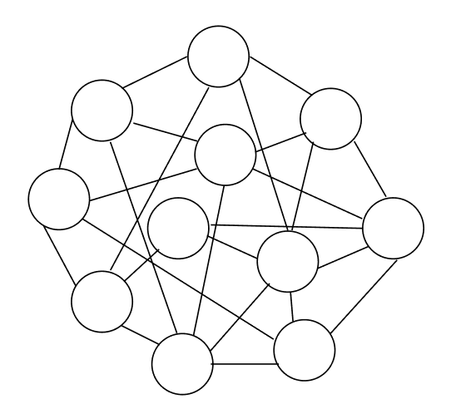
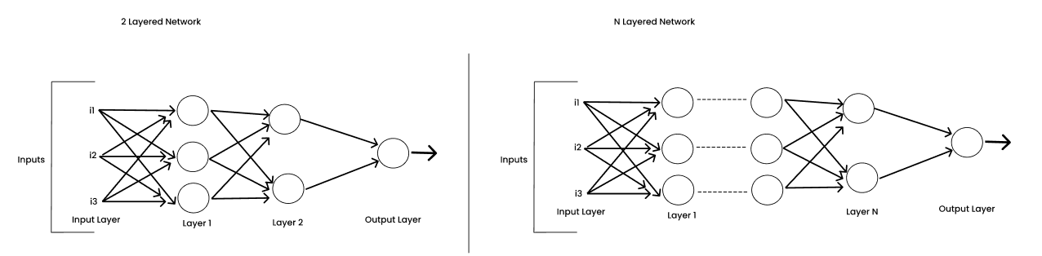
Why Neural Networks?
Challenges: Classical ML excels with linear or structured data but struggles with non-linear patterns (e.g., XOR, images, speech).
Examples of Non-Linear Data:
XOR logic gate: Classes not separable by a line.
Images: Complex patterns like faces or objects.
Text: Hierarchical language structures.
Why It Matters: Non-linear data is common in real-world tasks, requiring more powerful models.

Slide 8
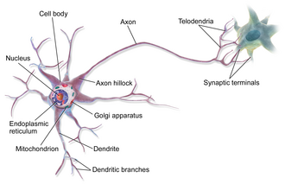
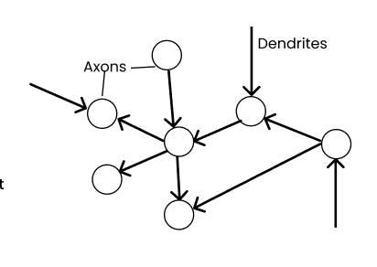
Biological Inspiration for Neural Networks
Human Brain: Neurons process inputs (dendrites), compute in cell body, output via axons.
Learning: Experiences strengthen synaptic connections (thicker = more important).
AI Mimicry: Biological Neuron
Inputs = data features (e.g., pixels).
Weights = connection strength.
Output = neuron firing.
Why Copy Biology? Brain’s efficiency inspires AI for complex tasks.

Slide 9
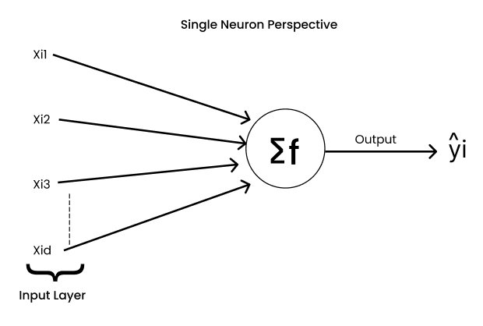
The Perceptron: First Step
Introduced: 1958 by Frank Rosenblatt.
Concept: A single neuron model inspired by biology.
Components:
Inputs: Data features.
Weights: Connection strengths.
Bias: Adjusts decision threshold.
Function: Computes weighted sum, applies activation for output.
Significance: Sparked AI by showing machines could learn patterns.

Slide 10
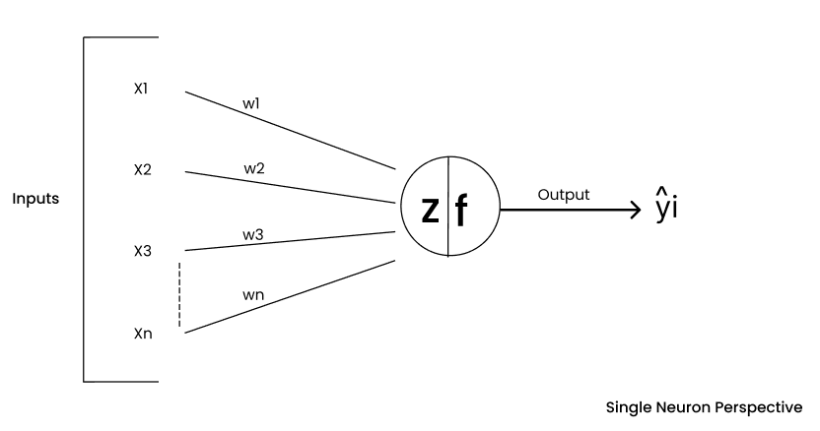
Mathematical Neuron Model
Equation:
Z = (w1 * x1 + w2 * x2 + ... + wd * xd) + b
w: Weights (feature importance).
x: Inputs (data features).
b: Bias (decision offset).
Activation: Output = F(Z), where F is the activation function.
Goal: Adjust weights and bias to minimize errors.

Slide 11
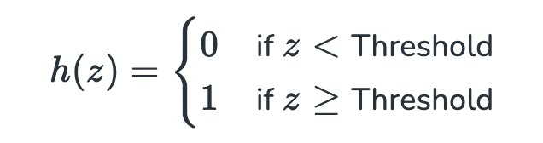
Step Function as Activation
Definition: Output = 1 if Z ≥ threshold; else 0.
Behavior: Binary (on/off), mimicking neuron firing.
Analogy: Light switch fully on or off.
Role: Used in early perceptrons for simple classification.

Slide 12

Limitations of the Step Function
Issues:
Non-differentiable: Prevents gradient-based learning.
Binary output: No nuances (e.g., probabilities).
Linear only: Fails on non-linear problems like XOR.
Impact: Limited perceptrons to simple tasks (e.g., AND/OR, not XOR).
Solution: Multi-layer networks with differentiable activations.

Slide 13
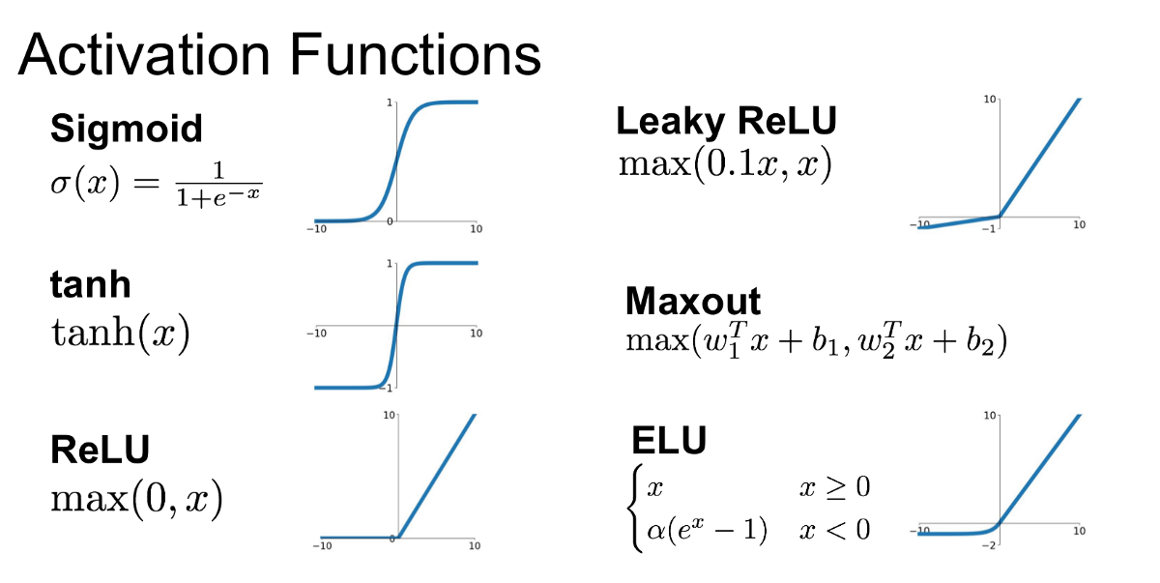
Activation Functions: Decision Makers
Role: Decide neuron output after weighted sum + bias.
Purposes:
Add non-linearity for complex modeling.
Control output range (e.g., 0-1 for probabilities).
Enable backpropagation via differentiability.
Types: Sigmoid, Tanh, ReLU (Rectified Linear Unit).
Analogy: Gates controlling information flow.

Slide 14
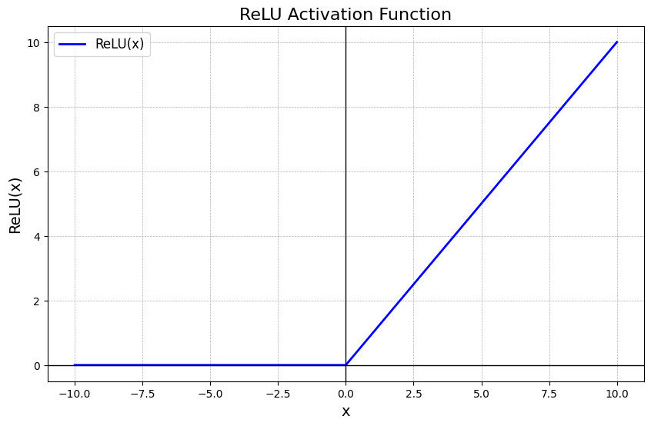
ReLU (Rectified Linear Unit)
Formula: ReLU(x) = max(0, x).
Behavior: Outputs x if positive; 0 if negative.
Advantages:
Fast and simple.
Avoids vanishing gradients (unlike sigmoid).
Promotes sparsity (many zeros).
Issue: “Dying ReLU” (neurons stuck at 0), mitigated by variants like Leaky ReLU.
Applications: Standard in deep learning (CNNs, Transformers).

